Slide 1


Dip in 5
Reading is fun 4
Association game

Slide 2
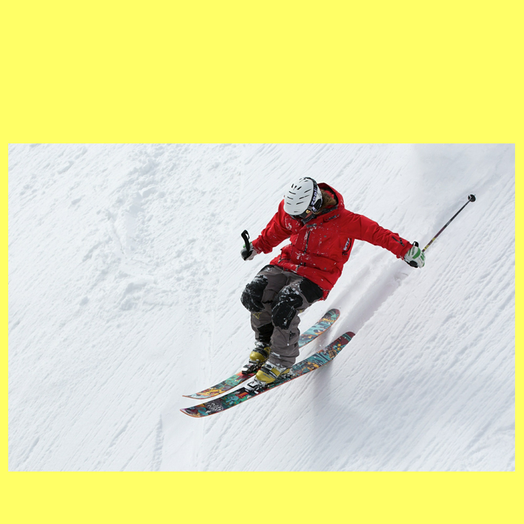
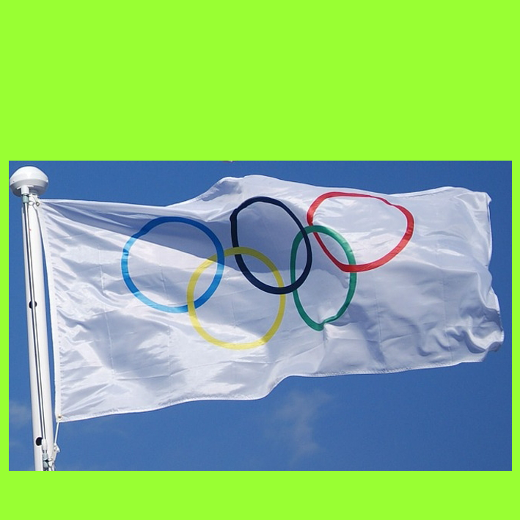
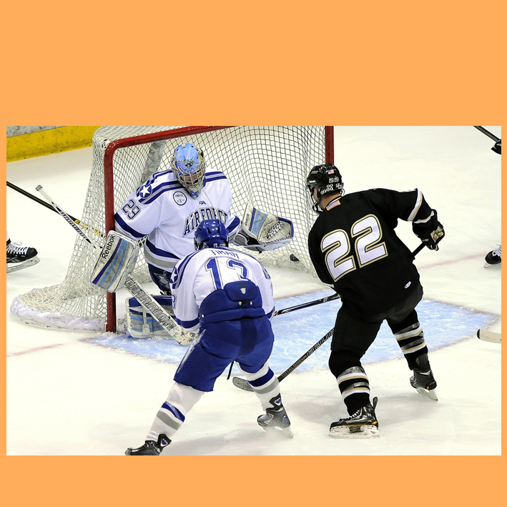
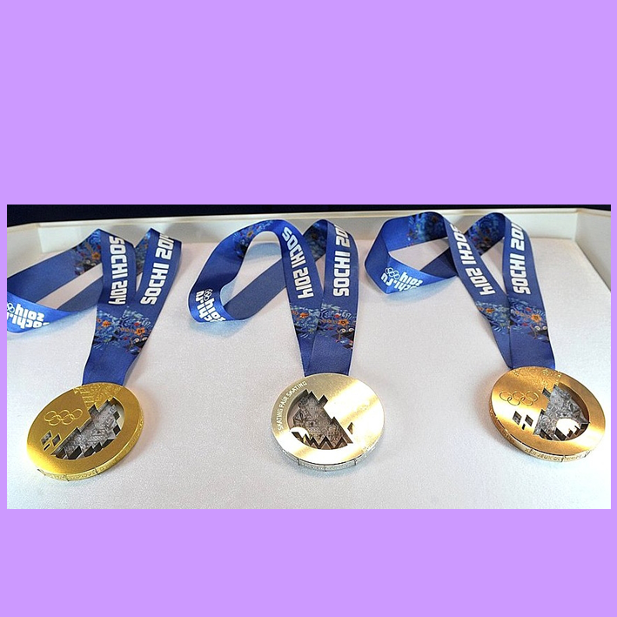

A1
slope
B1
white
C1
helmet
D1
neck
goggles
symbol
stick
A2
B2
C2
D2
gold
snow
5 rings
puck
silver
A3
B3
C3
D3
A4
skis
B4
continents
C4
ice
bronze
D4
COLUMN A
COLUMN C
SKIING
COLUMN B
ICE HOCKEY
THE OLYMPIC FLAG
MEDAL(S)
COLUMN D
THE FINAL ANSWER
WINTER OLYMPIC GAMES

